Slide 1

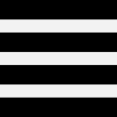






BloxOffice
Search
What’s Hot
Music
Sports
Arts & Theatre
Filters:
Toronto, ON
January 2017
Music
Jessie Reyez
Toronto
January 2
Francis &
the Lights
Toronto
January 6
Chance the
Rapper
Toronto
January 11
Paramore
Toronto
January 15
Daniel Caesar
Toronto
January 29
Gus Dapperton
Toronto
January 31

Slide 2

◁
Tickets: Toronto, Ca…
Jessie Reyez
Toronto
January 2
Chance the
Rapper
Toronto
January 11
Daniel Caesar
Toronto
January 29

Slide 3
BloxOffice

Slide 4


Slide 5
BloxOffice
Click to Enter

Slide 6




Divy
Profile Settings
Mill Street Roomies
Ski Trip 2017!!!
+ new group
Payment Status
+$30
Chores
Schedule

Slide 7


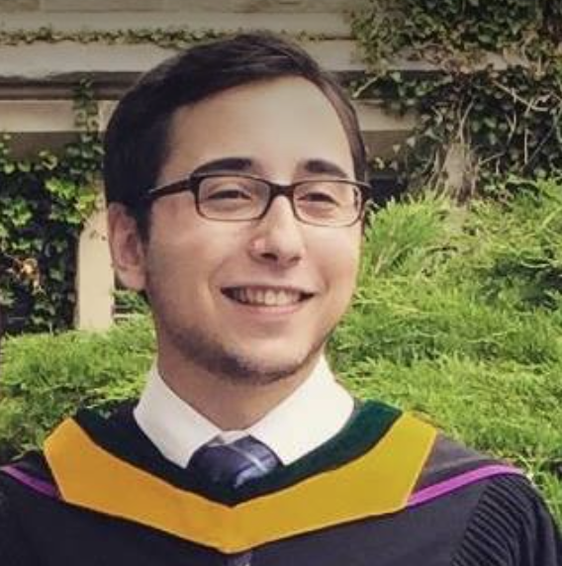
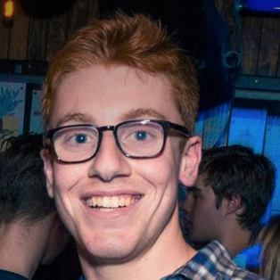

◁
Payments: Mill Stre…
Add Payment:
$ 35.00
Split Between:
Select All
✓
✓
Jason
Josh
Ethan
✓
Jeremy
Noah
Jason, Jeremy, Ethan Next >
Notes:
List what payment is for

Slide 8
◁
Payments: Mill Stre…
You are owed:
$72
Enter New Payment
Group Summary
Jason - is owed $72
Josh – owes $14
Ethan – owes $20
Jeremy – is owed $10
Noah – owes $48

